Slide 1
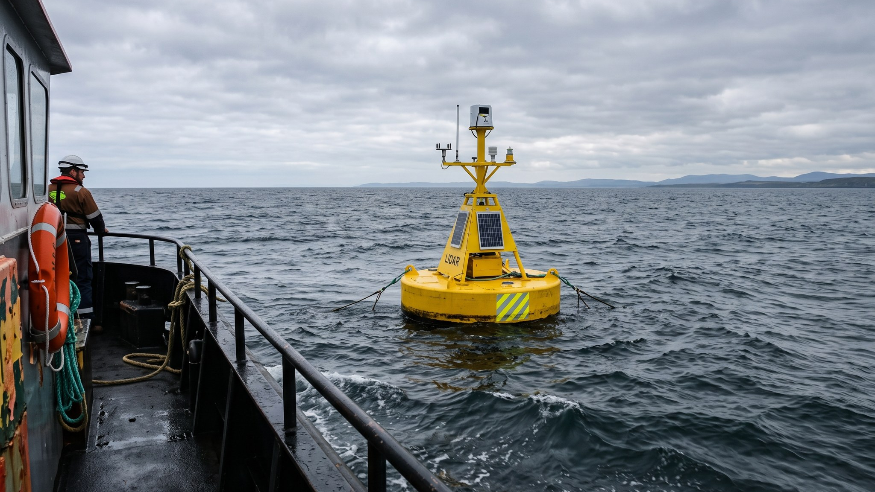
WEYLAND ENERGY
Harrow Bay – Energy Yield Review
Investment Committee pre-read · 27 November 2025

Slide 2
Headline numbers
1,900
1,689
45.2 %
9.2 %
GWh/a net P50
GWh/a P90 10-yr
net capacity factor
wake losses
• Wind resource and yield reviewed by the Lenders' Technical Adviser – no material findings
WEYLAND ENERGY · Harrow Bay – Energy Yield Review
2

Slide 3
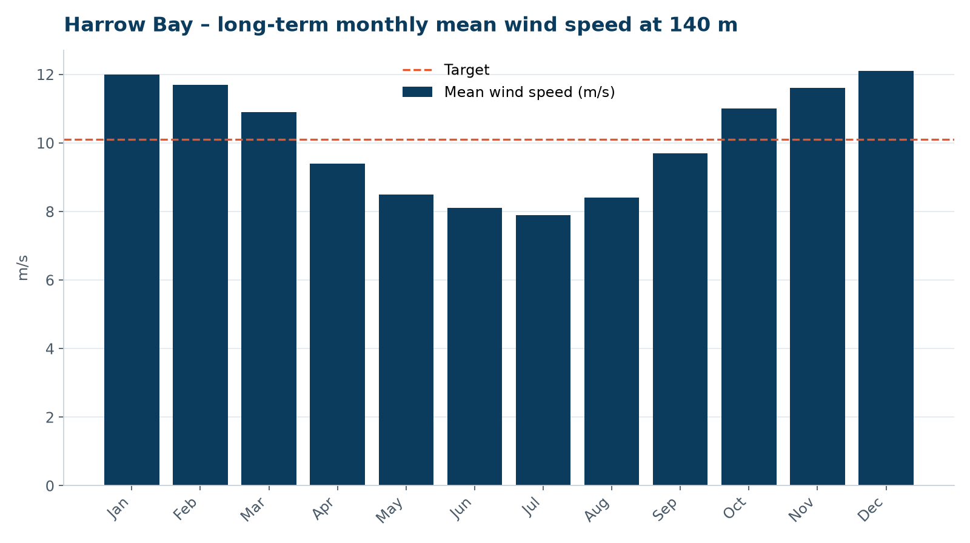
Wind resource
• Long-term mean 10.1 m/s at 140 m hub height
• 24 months floating LiDAR, ERA5 long-term reference
• Strong winter peak – summer is the construction window
WEYLAND ENERGY · Harrow Bay – Energy Yield Review
3

Slide 4
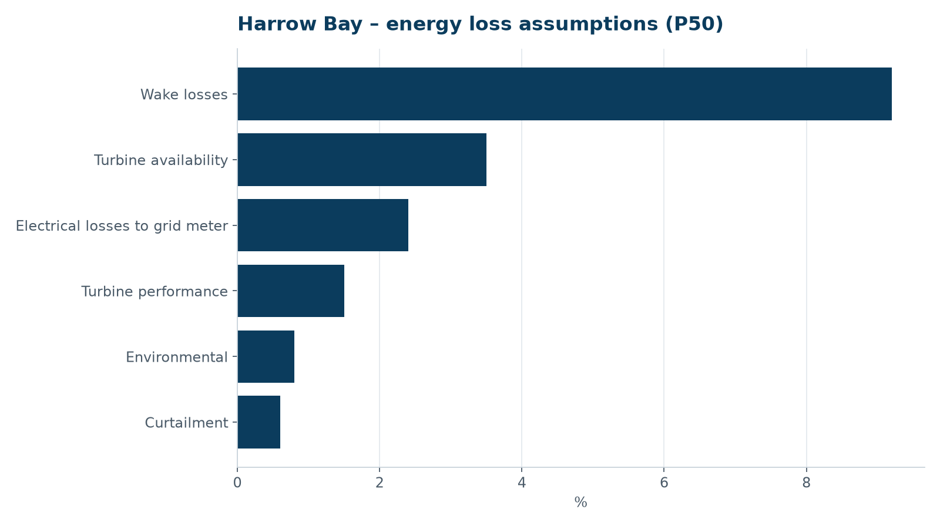
Where the energy goes
• Gross 2,287 GWh/a → net 1,900 GWh/a
• Wake losses are the biggest single loss
• Availability per Halden service agreement
WEYLAND ENERGY · Harrow Bay – Energy Yield Review
4
Notes:
Stress that the curtailment allowance includes seabird curtailment – Rachel Moss (Marlow Ecology) considers 0.2 % sufficient.

Slide 5
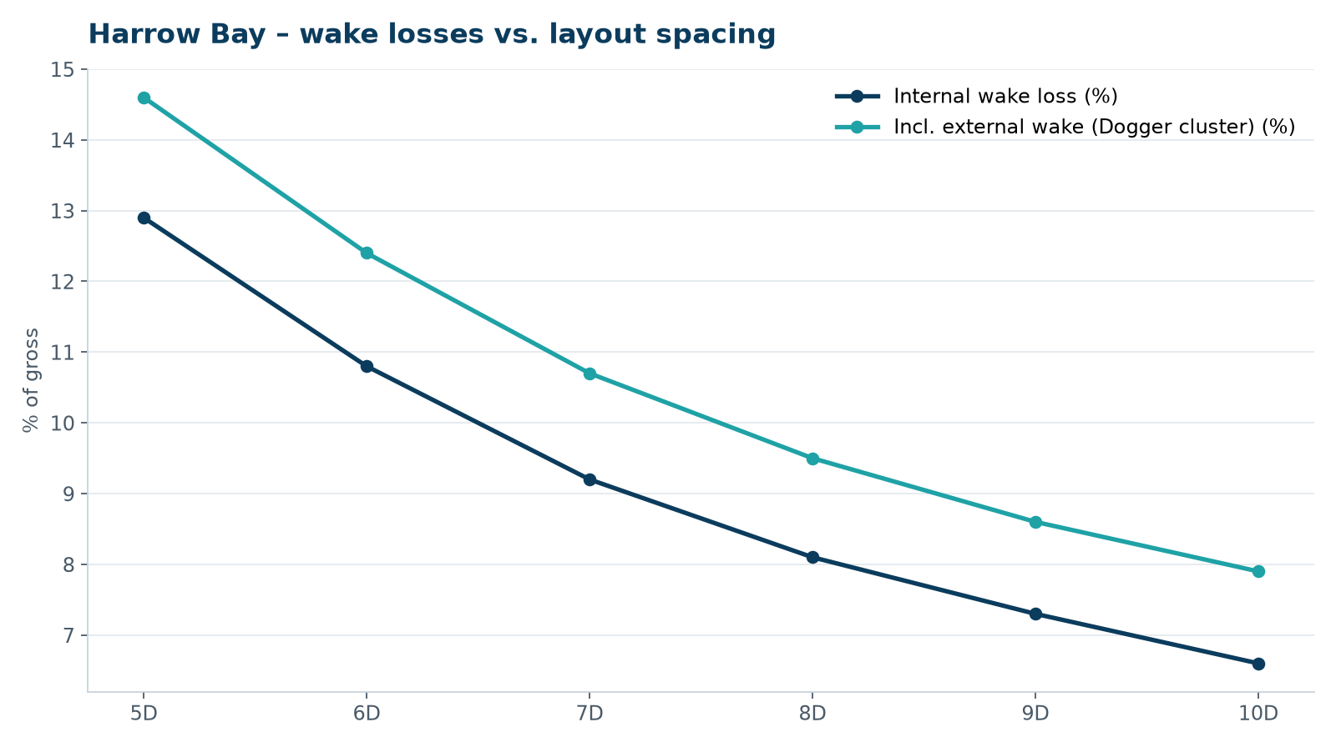
Layout spacing trade-off
• 6D would save ~4 km array cable
• …but cost ~30 GWh/a in wakes
• Layout frozen at 6.8D (Sept 2025)
WEYLAND ENERGY · Harrow Bay – Energy Yield Review
5

Slide 6
Exceedance levels
Level | GWh/a
P50 | 1,900
P75 (10-yr) | 1,789
P90 (10-yr) | 1,689
P90 (1-yr) – debt sizing | 1,641
WEYLAND ENERGY · Harrow Bay – Energy Yield Review
6

Slide 7
WEYLAND ENERGY
Recommendation
Adopt Rev 2 EYA as financial close base case

